Slide 1
Web Accessibility for Content Contributors
Notes:
:10

Slide 2
Team Intro
Khaled Arnaout - Web Designer (WA)
Sean Gnau - Web Designer (WA)
Joe Williams - Lead Web Designer (WA)

Slide 3
Agenda for the Afternoon
Quick Accessibility Overview
Headers/Links/Images – Oh My!
Color Contrast
Questions

Slide 4
Web Accessibility Intro
Web accessibility means making your website available to as many people as possible.
It’s a combination of good design, empathy and understanding.

Slide 5
Users Impacted by Accessibility
Disability on the internet includes things like:
Problems with sight
Problems using a mouse or keyboard
Problems with hearing
Problems with reading and comprehension

Slide 6
More than Disabilities...
But web accessibility also helps people who:
Have a slow internet connection
Have a small screen or unusual device
Can’t listen to sound in a particular place (library, crowded area, etc.)
Use an old web browser or operating system
Older users who might have problems with motor skills, text sizes and hearing
Late night viewing

Slide 7
Web Content Accessibility Guidelines
WCAG is the most common standard when it comes to web accessibility
WCAG 2.0 is organized into 3 conformance levels:
Level A encompasses the most basic web accessibility features
Level AA consists of the biggest and most prevalent barriers encountered by disabled users.
Level AAA deals with the highest and most involved accessibility issues
Cornell’s Web Accessibility Policy will be based on WCAG 2.0 level AA (which includes both A and AA levels)

Slide 8
Content
Ideally, content creation should happen before design/development have started.
Findability and Readability
Content is not just copy. Content is copy and images, videos, documents and even forms!

Slide 9
Considerations for Content Editors
☑Semantics and Structure ( Headings, lists, menus, forms, etc.)
☑Readability ( Order )
☑Images (Alt attributes)
☑Tables ( Data tables, layout tables )

Slide 10
Purpose of Headings
Headings outline your site.
Headings act as “anchors” that screen reader users can jump to.
Notes:
Sean

Slide 11
Headings
Each heading MUST describe the content to follow.
Headings MUST NOT be empty.
Headings SHOULD be concise.
Notes:
Sean

Slide 12
Heading Pitfalls
Using Headings to have differently styled text (usually to make text larger/bolder)
WYSIWYG Editors: Hitting Return when headings are being typed for increased white space. (Blank headings)
Not being careful with the structure of the headings (wrong heading levels)
Using bold paragraph text as headings.
Notes:
Sean

Slide 13
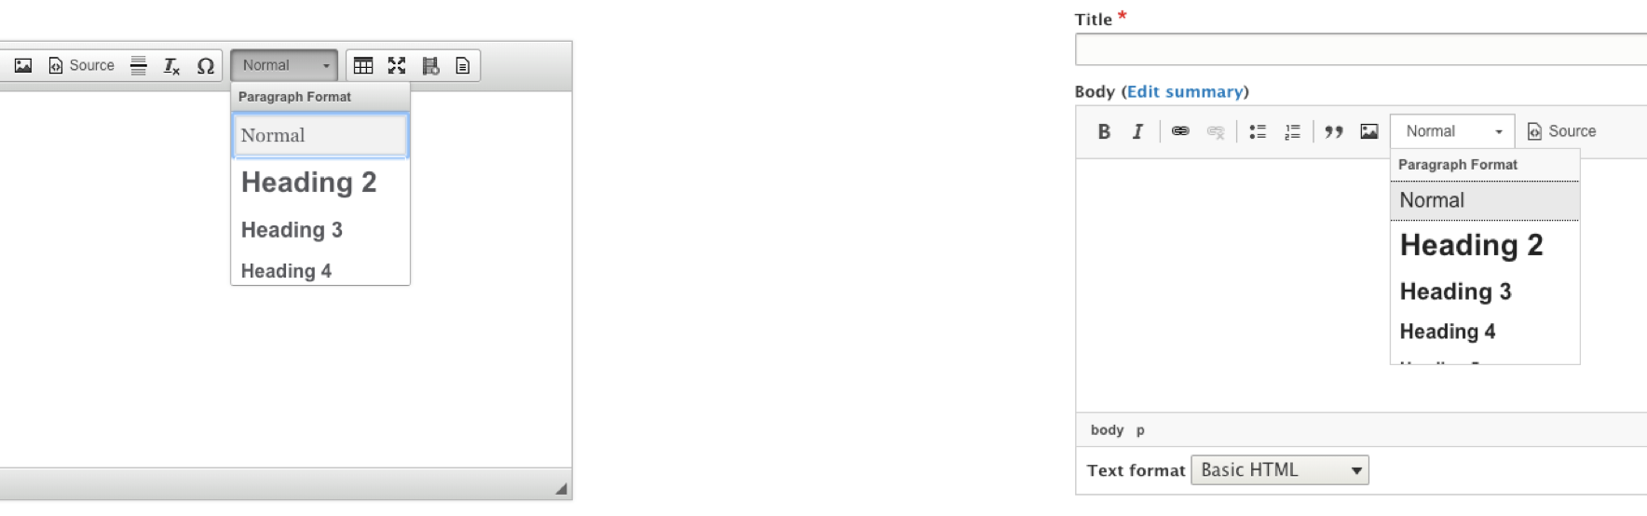
Inserting Headings
On the editor, click on the drop down menu and select your desired Heading Level.
Note: Most themes use the Title of the page as Heading 1. You will most likely want to use Heading 2 and below for all your headings in main content.

Slide 14
Links
Links navigate to a location described by the link text or image and alternative text.
Links MUST not lose the ability to be focused by tabbing navigation.
Links MUST visually appear distinct from surrounding text.
Links SHOULD open in the same window (and same tab), unless the link explicitly indicates it will open in a new window.
Notes:
1) Tabbing Navigation is using the TAB key to navigate between focusable elements on a webpage.
2) No comment.
3) Strategies: You can achieve this through

Slide 15
Link Text
Links should be concise. A word to a short phrase is sufficient, not a sentence or longer.
Links must not be empty or broken
Do not use generic link text such as “read more” or “click here”
Link text MUST describe where the user will navigate to.
  This does NOT mean using the URL as link text.
  Identical link text may not repeat unless there is enough context
Notes:
As much as possible …

Slide 16
Context
Appropriate context for a link includes
  Same Paragraph
  Same List Item or Parent List Item
  Described by table
<p>Find out more about Cornell DrupalCamp 2019 <a href=”...”>here</a></p>
<p>Find out more about Cornell DrupalCamp 2019 <a href=”...”>here</a></p>
<p>Find out more about Cornell DrupalCamp 2019 <a href=”...”>here</a></p>
Brand | Company 1 | Company 2
Ford | $39/day | $45/day
Honda | $37/day | $39/day
Audi | $45/day | $42/day
DrupalCamp 2018
  Presentations (PDF, Word)
DrupalCamp 2019
  Presentations (PDF, Word)
DrupalCamp 2018
  Presentations
  Slideshows
DrupalCamp 2019
  Presentations
  Slideshows
Notes:
There are more, but they are more developer focused.

Slide 17

Images and Alternative Text
Alternative text is a text replacement for an image.
Images that are “informative” require alt text that fills in any missing context that is not present in content
Images that are “decorative” require alt text that has a value of nothing.
  In Drupal: Leave the alternative text field empty OR add double quotes (“”) until the code shows:
  <img src=”...” alt=”” />
Images that are links require alt text describe the destination of the link.
alt = “Cornell President Martha Pollack”
But context is important when considering proper alt text

Slide 18
Tables
Tables are used to organize and present tabular data such as financial results, calendars, etc. Data cells need to be associated explicitly with header cells so screen reader users have an easier time navigating and understanding the content of the data table.
Describe complex data tables using the summary attribute in the table tag.
Describe all data tables by adding a Caption in the table menu, even if you have a heading directly preceding the table.
Use th elements to tag columns or row headers; nest these headers in a thead tag.
Associate data cells explicitly with their appropriate headers using the headers and id attributes.

Slide 19
Media
Videos and live audio must have captions and, in most cases, should have a transcript.
Auto-captions need to be edited for accuracy.
With archived audio, transcripts may be sufficient.
Audio descriptions: may be required but can be avoided if visual content is being conveyed through audio.

Slide 20
Non-HTML Content
PDFs, Word docs, PowerPoint presentations
and Adobe Flash content
First thing to consider - can it be made into accessible HTML-based web content?
If it needs to stay in its current format, make sure it’s accessible.

Slide 21
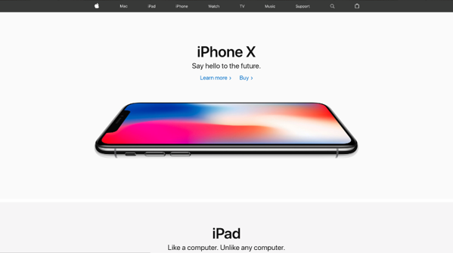
Accessible Website Truth:
Accessible colors go beyond just the BRIGHT blue color, or yellow on black that come to mind. There are many color combinations to choose from.

Slide 22
1.4.3 Contrast (Minimum) (Level AA):
Contrast minimum is:
The visual presentation of text and images of text has a contrast ratio of at least 4.5:1, except for the following:
Notes:
Joe

Slide 23
Exception 1
Large Text
Large-scale text and images of large-scale text have a contrast ratio of at least 3:1;

Slide 24
What does that mean?
Type size determines the ratio
•Text that is 18 point, or 14 point bold and above only needs to be 3:1 ratio.
•Under 18 point text or 14 bold needs to be 4.5:1.

Slide 25
18pt equals 18px…right?
Points ≠ Pixels.
•The calculation is about 1pt = 1.333 px.
•So a 18pt text is actually 24px.
18pt = 24px
14pt = 19px

Slide 26
Exception 2
Incidental
Text or images of text that are part of an inactive user interface component, that are pure decoration, that are not visible to anyone, or that are part of a picture that contains significant other visual content, have no contrast requirement.

Slide 27

What is pure decoration?
Serving only an aesthetic purpose, providing no information, and having no functionality

Slide 28


Exception 3
Logotypes
Text that is part of a logo or brand name has no minimum contrast requirement.

Slide 29
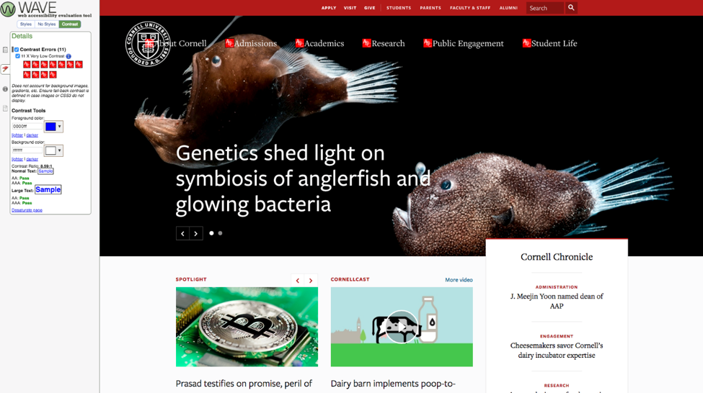
Use WAVE
Notes:
Joe

Slide 30
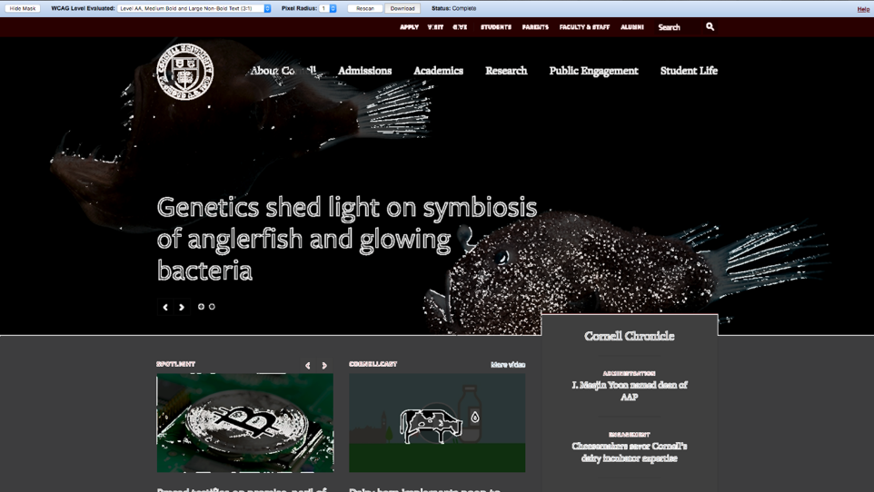
Color Contrast Analyzer
Notes:
Joe

Slide 31
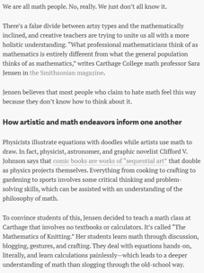
Don’t use color alone
Don’t use color alone to indicate things that are important.
An example would be links. If you don’t have an underline for a link and the contrast is low, users will have a difficult time figuring out what is body copy and what is a link.
Links in body need 4.5: 1 with background and text, and 3:1 between surrounding text and link

Slide 32
Wrapping Up

Slide 33
Testing
Siteimprove - https://siteimprove.com/
WAVE - https://wave.webaim.org/
WCAG Color Contrast Analyzer - Chrome & Firefox Extension
Notes:
Joe

Slide 34
Manual Testing
Tab through the site, does the tab order make sense?
Does your tab ever get locked into a place?
Manually check alt tags, do the alt descriptions fit?
Are there other indicators besides color?

Slide 35
Review!
Make sure someone who is knowledgeable in accessibility guidelines reviews all content before publishing
Content is never “settled”, must always be checking it to make sure it is still accessible

Slide 36
Questions
Email us at webaccessibility@cornell.edu

