Slide 1
Bricks & WYSIWYG Paragraphs
Impressive Pages Without Ongoing Development
Notes:
Hi! I’m Kasey, and I’m the Front End Web Developer at the Unitarian Universalist Association in Boston, though I’m based here in Ithaca. We’re in the process of migrating from Drupal 7 to Drupal 8, and what I’m going to show you today is the direction we’re taking for our page content type.
We have a really great relationship with our content providers, so we know they’re going to be over the moon about the flexibility and power this setup will give them. We also care a lot about usability and accessibility, so from the back-end, we’re thrilled at the structure, tracking, and security this approach to embedded media gives us.

Slide 2


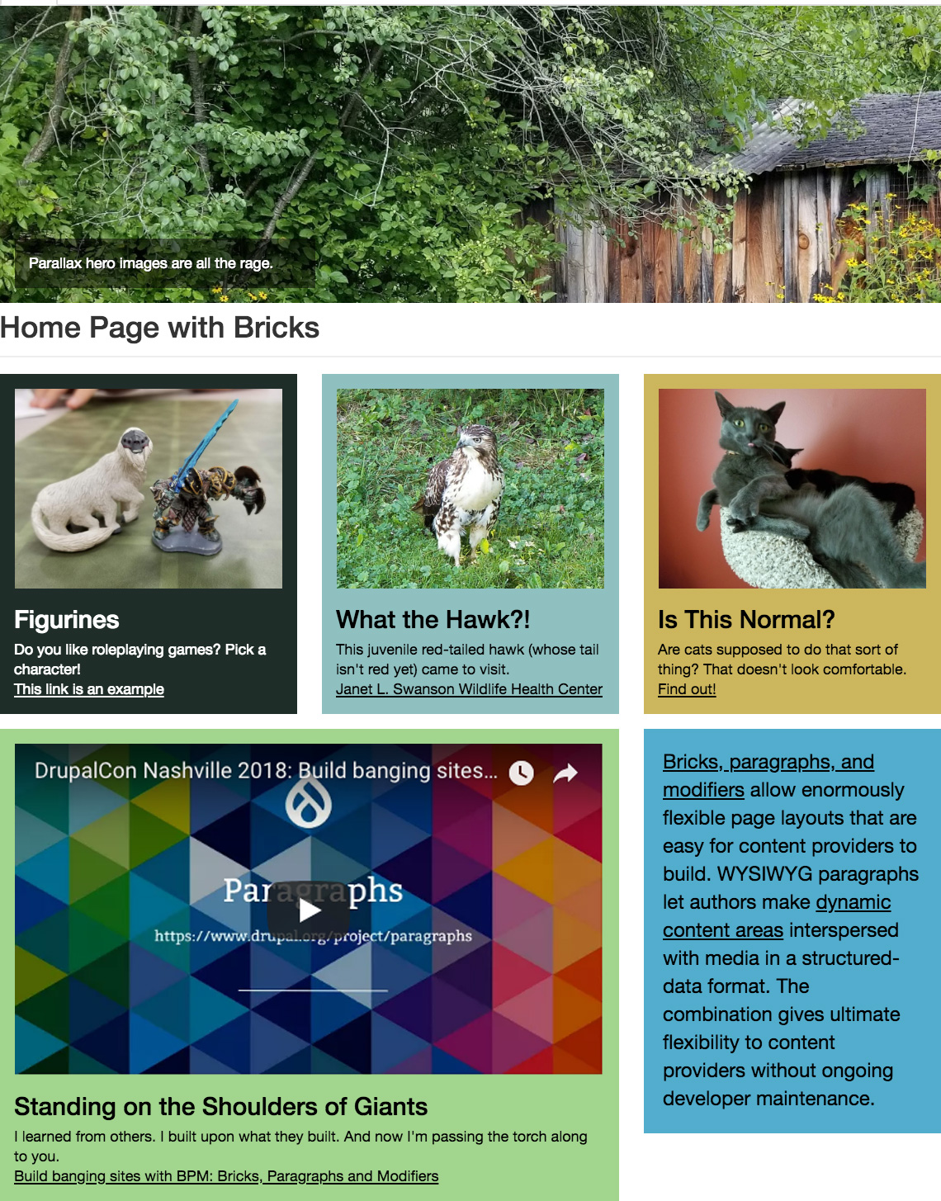
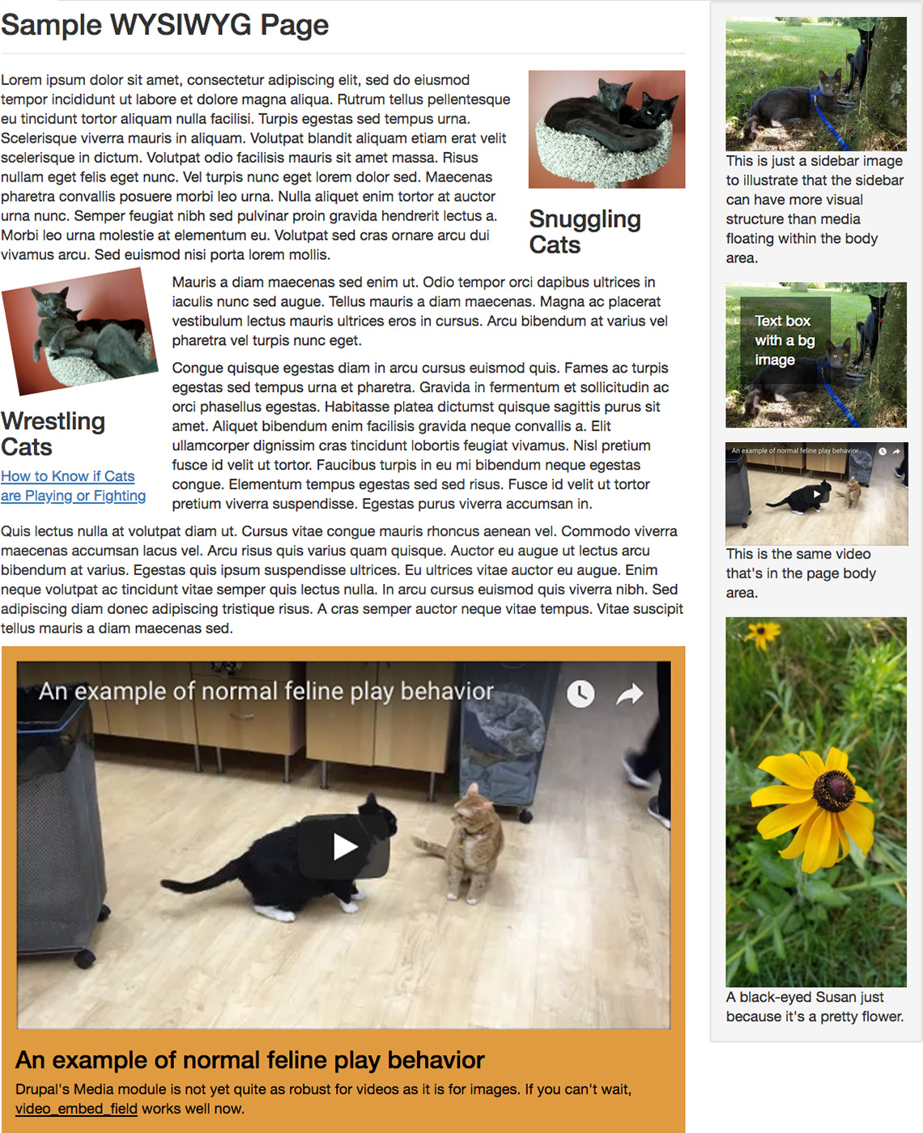
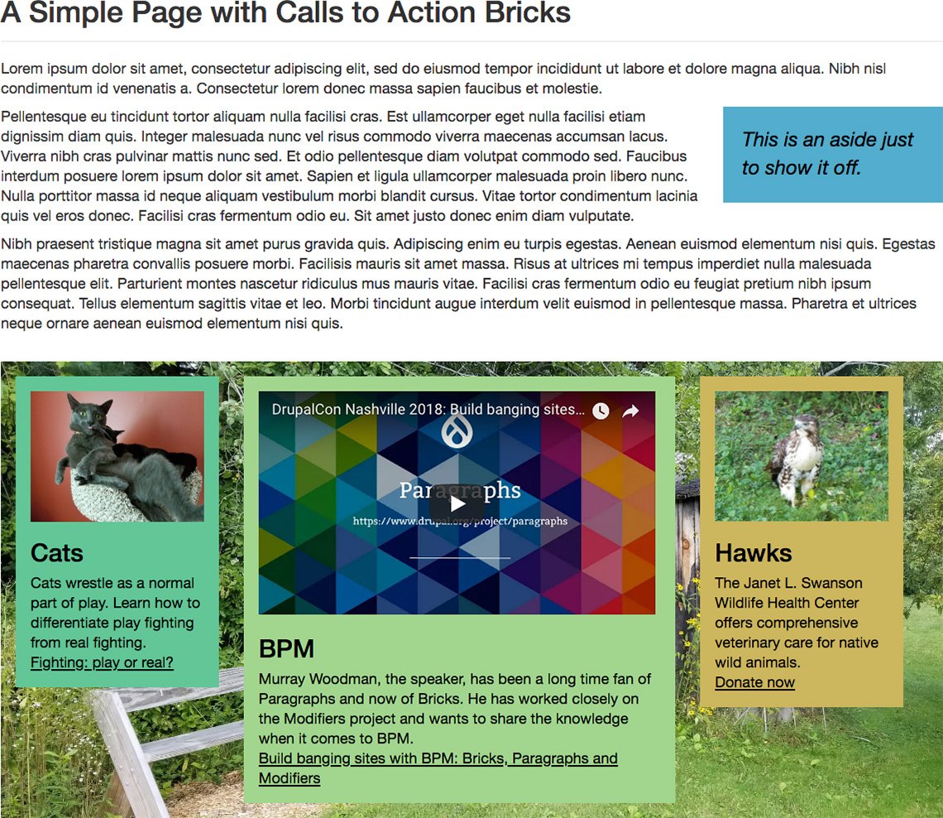

One Content Type, Many Layouts
z
z
Notes:
Here are three quite different-looking pages. The first is a rather structured layout of boxes in rows and columns. The second has a column of text and media in its sidebar, but its content area is a bit more free-flowing, with media floating among and between the paragraphs of text. The third shows a simple text area followed by a colorful row of media boxes.
Our site has over 30,000 pages in it, and over the course of 20 years, our content priorities and site organization has shifted a number of times. Being able to easily turn ”regular” pages into ”landing” pages or pages with special promotions – and back again – will greatly simplify our ability to accommodate priority shifts. And staff will be able to do it themselves, without developer involvement to change something’s content type or reorganize menus from one node to another.

Slide 3
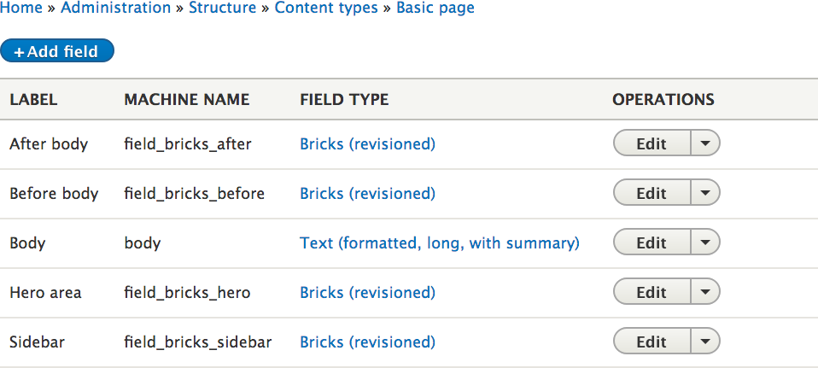
From Only a Few Fields
z
z
Notes:
The content type which produced all those pages is quite simple: it’s got a body field and a few “Bricks” fields for different regions of the page layout.

Slide 4
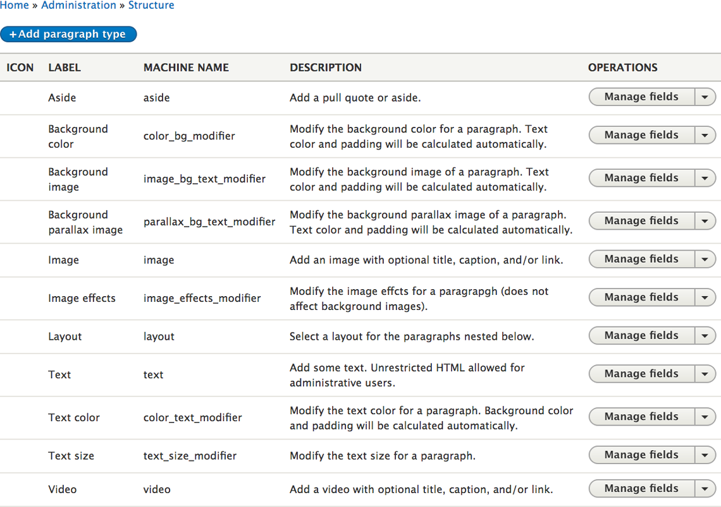
Paragraphs Enable the Options
z
Content
01
Styles (Modifiers)
03
Layouts (Bricks)
02
Notes:
“Paragraphs” are where the magic lies. Today we’ll be talking about three kinds of paragraph types: content paragraphs are where page authors can upload media or text; layout paragraphs (from the “Bricks” module) let an author arrange their content paragraphs into rows and columns; and modifier paragraphs (from the “Modifiers” module) allow authors to change the styles on their content or layout paragraphs.

Slide 5
Paragraphs
Paragraphs are fancy, flexible field collections.
Enter data to be displayed together: image & caption, title, link.
Developers can easily manipulate the output, e.g. apply the link to the image, use semantic markup, add custom scripts or styles, etc.
Users can embed media via a secure input method; they don’t need unrestricted HTML when using fields with custom formatters.
Data is structured: people aren’t pasting in code pieces that are hard to secure, track, or update.
Notes:
“Paragraphs” are basically fancy field collections. Each paragraph type can contain as many fields as you want, and they can be used to create mini entities that can be displayed on a larger entity like a node. With inline entity forms, those paragraphs can be created and edited right from the node edit form.
Paragraphs make it easy to bundle information that ought to live together. For example, when you display an image on a page, you might want to associate it not only with a caption, but perhaps also with a title and link field. Maybe you want the link to be applied to the image as well.
Paragraph entities are easy to manipulate and display, so it’s easy for developers to adjust their semantic markup or include custom styles or scripts. Content providers don’t need access to unrestricted HTML to paste in, for example, an embedded Tweet; you can give them a field that strips out any potentially harmful code, and load the necessary scripts via the appropriate Drupal methods. If that embed code or script is updated, you don’t have to track down every body field with code in it; you just update the field formatter.
Because authors are using special fields for special content, your data is structured: if you need to know which page(s) are displaying a Google map, you can find out!

Slide 6
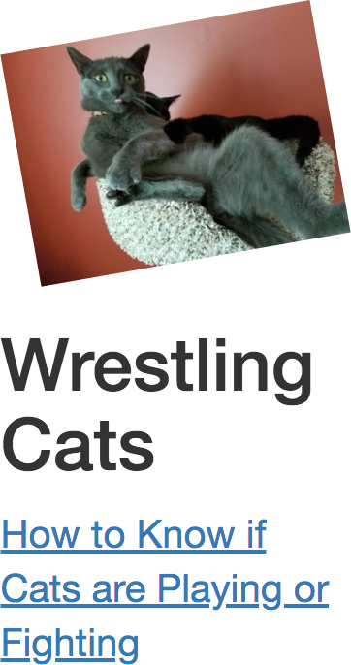
Modifiers
z
Modifiers let your content providers apply effects to their paragraphs:
  Background color, image, or parallax
  Text color or size
  Image effects (CSS filters)
  Minimum height
  …with adjustments at different breakpoints
Notes:
“Modifiers” are a special paragraph type that can be applied via a field on other paragraph types.
In the example on this page, an image paragraph (with an image, a title, and a link) has an “image effects” modifier on it which adjusts the rotation and scale of the image.

Slide 7
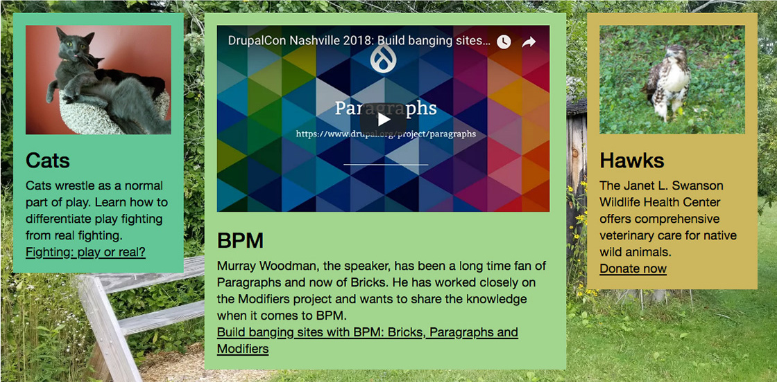
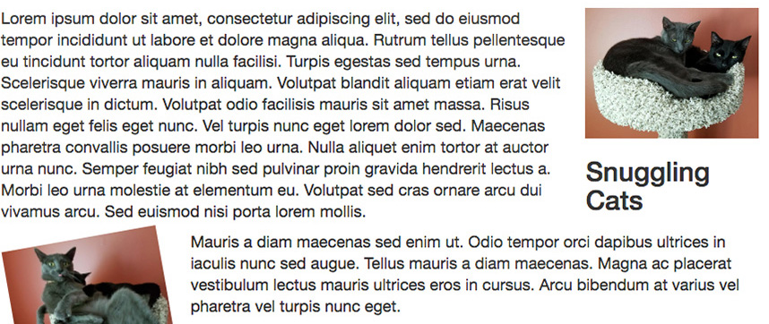
Bricks vs. WYSIWYG
z
Bricks: apply layouts to paragraphs, e.g. “Show the next items in three columns (1:2:1).” Developers provide layout options and determine breakpoint variations.
WYSIWYG entity embedding: pepper a text field with paragraphs that have a variety of floats or widths.
Notes:
Bricks and WYSIWYG (or What You See Is What You Get) fields are two ways we can put paragraphs on a node.
The top example is using bricks fields, and the bottom example is using CK Editor, the WYSIWYG that comes with Drupal core.

Slide 8
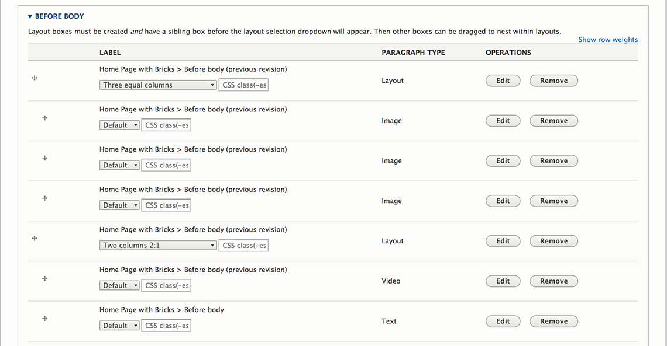
Bricks Input
Notes:
A bricks field allows an author to stack paragraphs one after the other, and to nest them under layout paragraphs.
The really cool thing about this is that any content provider can make amazing, dynamic home or landing pages with exciting media callouts.
A developer can provide different layout options and set up styles so they’ll be appropriately responsive at different screen sizes. Contrib modules like bootstrap_paragraphs provide some ready-made layouts. Once that’s done, content providers can make pages that look like they come from totally different content types without any additional development.
The downside is that the edit form is a bit clunky. You can’t see any of the content that’s within each paragraph, or whether it has any modifiers applied to it. Except for the layout selection, you have to click “Edit” to make any changes or see what’s inside (unless you’re good at counting boxes and remembering which one you’re trying to edit).
I know our users will be so thrilled to have the flexibility this offers that they’ll be willing to put up with this clunkiness (and they’re already used to that from our current implementation of paragraphs in Drupal 7). Hopefully there will be ongoing improvements to the bricks UI, making it a little more user-friendly as time goes on.

Slide 9
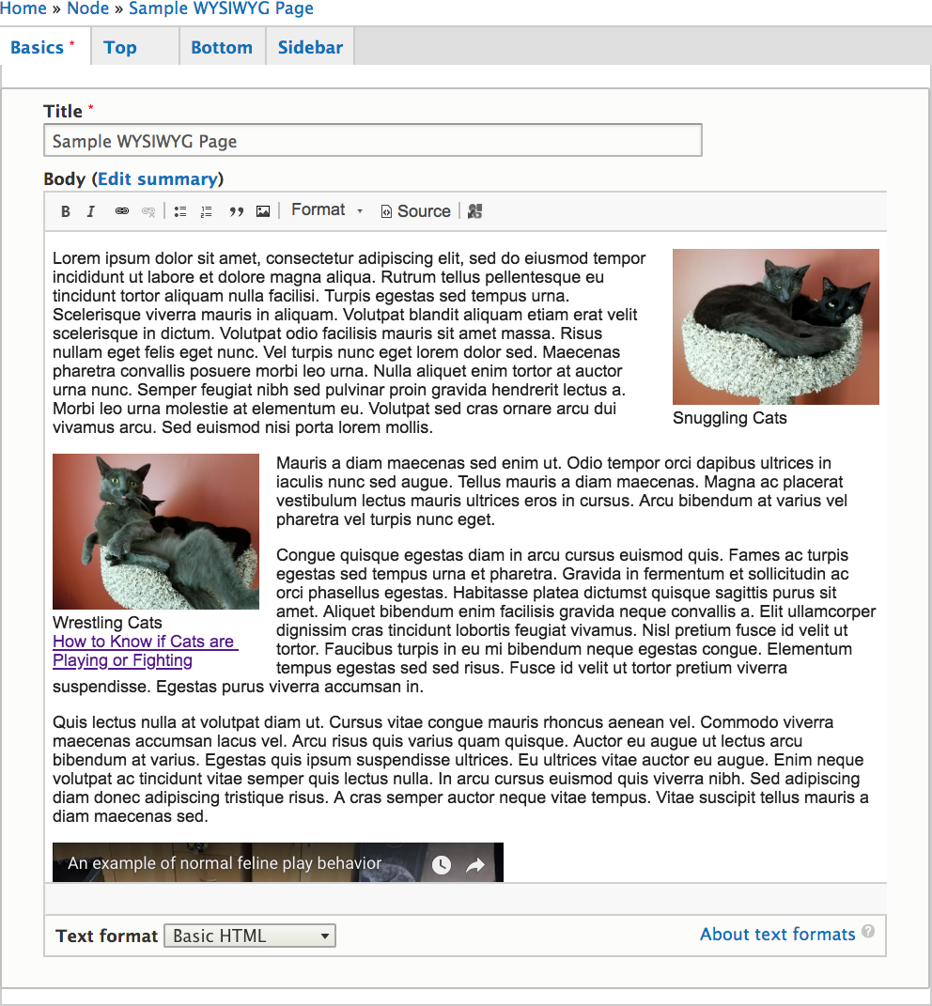
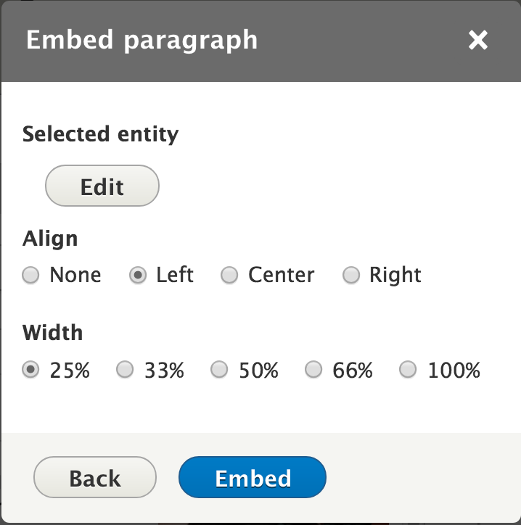
WYSIWYG Input
z
z
Notes:
Entity embedding, on the other hand, gives an author a really intuitive, easy-to-use What You See Is What You Get page editing screen.
It’s super easy to create and move embedded paragraphs within a text field, and honestly, even if everything else about Drupal 8 totally sucked, this would be enough to make our users sing our praises all year long.
Modifiers don’t show in the WYSIWYG window, but I don’t think that will dim our users’ enthusiasm.
Layouts won’t work in this environment; without bricks there’s no way to nest paragraphs under a layout selection. But with bricks fields both above and below the body field, authors can do some neat stuff at the top or bottom of their page.
We anticipate that the vast majority of our pages will make exclusive use of this WYSIWYG interface, so most of our staff won’t even have to bother with the clunkier bricks input, and won’t even see it unless they click on one of the closed form tabs.

Slide 10

Why not just embed images or video?
z
A single “embed stuff” button simplifies your WYSIWYG.
Using paragraphs for everything standardizes the workflow.
Paragraphs fields & displays are easier to adjust than media embeds (e.g. applying a link field to an image) – and most/all of it can be done via the GUI.
Modifiers apply easily to paragraphs.
Notes:
Drupal 8 makes it super easy to embed media and retain structured data, but we’ve found some compelling reasons to go strictly with embedded paragraph entities instead.
For one thing, we really try hard to minimize our authors’ learning curve. The simpler we can make our edit forms, the better. Having just one button to “embed stuff” instead of having to decipher a bunch of different icons that do similar things definitely helps with that. And once you click on that button, the workflow for any type of paragraph is quite similar.
We also like how easy it is to create and manipulate paragraph types. Being able to add a link to the image as its displayed on a particular node is surely doable without paragraphs, but with paragraphs, you don’t even have to leave the GUI.
And being able to use modifiers to easily add background colors or image effects to the entire entity will give our authors a lot of options.

Slide 11
github.com/KaseyMK/bricks_wysiwyg
Drupal 8.6
Modules, patches, and libraries
  See composer.json, patches/composer.patches.json, web/libraries, and web/modules/custom
A Bootstrap-based theme with layouts, styles, and templates (see web/themes/custom)
Config/sync files
  Paragraphs & Page
  Color taxonomy with view
  Entity browsers
  Text editor embed button
  Text formats and editors
  Block layout
  Image & responsive image styles
  Display modes (media & paragraph)
Notes:
I have prepared a Drupal installation with all the functionality I’ve shown you. Feel free to download and install, use it as a start for a new site, or explore the files in order to get things working on your own site.
I’ll give you a quick run-through of what it contains, and then I’ll answer questions and open up a local site to show you around.

Slide 12
Custom Paragraphs
Included:
Image & Video: media, title, caption, link (output as <figure> element with <figcaption>)
Aside: text output as <aside>
Text: Full HTML for trusted users
Ideas:
Facebook feed or post, blog feed, block, view, button, Google map or presentation, Flickr slideshow, accordions, carousels…
Tweet: custom field formatter for safe markup & Drupal script-loading
z
Notes:
The site includes some simple paragraph types, with custom twig files to adjust their semantic markup, a sample custom field formatter to output SafeMarkup and a Drupal-loaded script, and a couple of contrib modules to improve usability or output. For example, we use the allowed_formats module to prevent the use of Basic HTML inside a paragraph’s text field: we don’t want paragraphs embedded within paragraphs embedded within paragraphs ad nauseam! And linked_field lets us apply a link field’s URL to an image.
A production site will probably want lots more paragraph types, many with custom field formatters so we can safely add scripts or styles as necessary without letting our authors paste in any old code or having to understand HTML or CSS themselves.
bootstrap_paragraphs includes paragraph types which let you easily create features like Accordions, Carousels, Modals, Tabs, and Multi-column layouts. You may need different versions of these paragraph types for use in the WYSIWYG or within your bricks fields, or choose to enable them in only one or the other.

Slide 13
Custom Modifiers
Based on modifiers_pack
Customizations include:
More instructions & cleaner forms
Select fields, not open entry
Automatic padding with backgrounds
Screen width and min-height settings on relevant modifiers
Calculate the most accessible text/background color
z
Notes:
The modifiers_pack module is really awesome, with a lot of great style options that work right out of the box.
There were, however, a lot of tweaks I wanted to make for our use case, so I examined the modifier modules that came with that pack, copied some of them, and then expanded or adjusted them to meet our needs. Feel free to do the same! I believe that all my custom modifiers are compatible with modifers_pack, so you could just grab the ones you want and enable them side-by-side.
I didn’t want to give our users open entry fields for things like text sizes or screen widths; I wanted to give them select fields and a little more explanation about what those would do. I also tidied up the input forms a bit with field groups.
Instead of having a separate modifier for padding, I add padding automatically when there’s a background image or color. Instead of having a separate height modifier, I include that field where it made sense to me – like when there’s a background image you want to be sure to show. And not all modifiers have a screen min-width setting; for example, text size does, but background color does not.
Instead of lettings our authors select both the background color and a text color, I set our modifiers up to calculate the relative luminosity of the selected text or background color against black or white, choose the better-contrasting of those, and use that for the background or text.
And though I kept the fields for hover effects, I have them all disabled by default since we generally try to keep moving parts to a minimum.

Slide 14
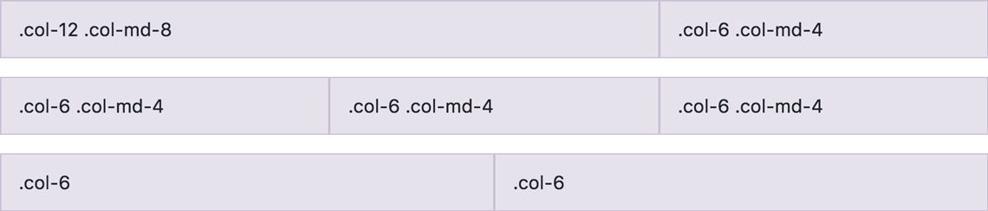
Custom Layouts
The Bootstrap theme has preset classes like “col-xs-4” for layout files (web/themes/custom/bricks_wysiwyg/templates/layout) but these layouts could be adjusted for use with any theme.
theme_functions hides a confusing layout that comes with bricks.
layout--onecol-all.html.twig provides a single-column layout that shows up to 12 children (the default single-column layout only shows the first child but it can’t be hidden or overwritten).
Notes:
I’ve included a number of layout templates based on the Bootstrap theme to get started, but they’re pretty simple. Depending on your site’s layouts and breakpoints, you may want to make adjustments to make sure everything looks good at all sizes.
This is an area where training your content providers will be helpful. You can’t predict all the ways your layouts will be used, so you’ll make some pretty generic choices about where columns should break. Authors should be encouraged to wiggle their browser windows to make sure their choices look good at all widths.

Slide 15
Custom Patches
z
A width filter allows embedded entities to be 25%, 33%, 50%, 66%, or 100% wide (using view modes puts classes on the entity but not the necessary parent div).
That width filter re-sets the view mode of image paragraphs (which use different responsive image styles). Users don’t have to also select view modes (which sound the same as the width options and don’t matter on most paragraphs).
Notes:
I’ve included a couple of custom patches to the entity_embed module to support our use case.
I wanted to be able to embed a paragraph and have it be a particular width of the body field. Applying a view mode would let me embed an entity that was a particular percentage of the browser window, but that wasn’t what I wanted. And it didn’t put a class on the appropriate containing element, so I couldn’t just use CSS to make it happen either. Therefore, I made a custom embed filter that lets the author set a width style on the paragraph’s containing element.
I did also want to use different view modes for images, so we’re not sending out images much larger than required, but I didn’t want to show our users the display mode select list as well as the width radio buttons, since it would seem like duplicated effort to them, so I also made a patch to use the selected width value to set the view mode.

Slide 16
Bricks & WYSIWYG Paragraphs
Any questions?
z
z
Notes:
Any questions?

Slide 17
Kasey Melski Kruser
Front End Web Developer
Unitarian Universalist Association
kasey.kruser@gmail.com
https://www.drupal.org/u/kasey_mk
https://github.com/KaseyMK/bricks_wysiwyg
Notes:
Here’s my contact information and once again the address of the GitHub repo where you can grab the sample site and dig in!
Thank you!

