Slide 1
Centrally Managed Content with JSON Views and the Feeds Module
Neal Heneghan (nealhene on drupal.org and twitter)
Web Front-end Developer
10.10.15

Slide 2
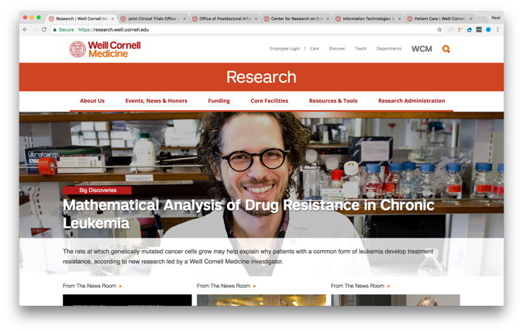
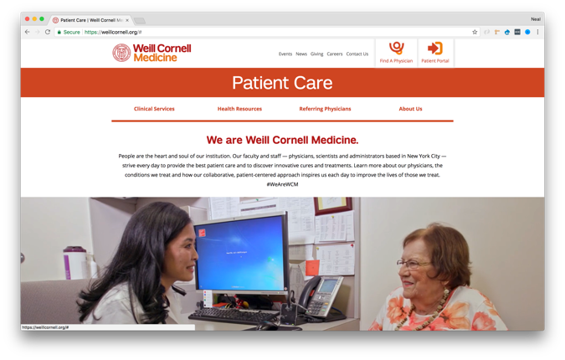
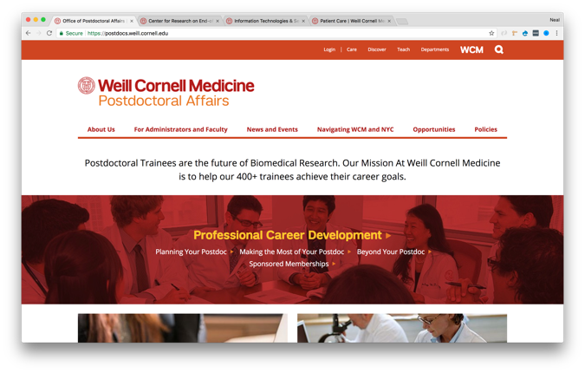
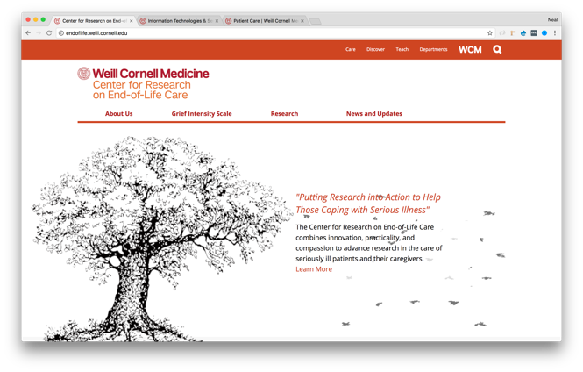
What I Do
Front-end, Drupal Developer
Theming and site building.
Weill Cornell Medicine has 100+ sites, 70+ are on Drupal 7.
All sites on Drupal 7 by March 2018. 🤞
Once all sites are on Drupal 7 we will begin to migrate to Drupal 8.

Slide 3
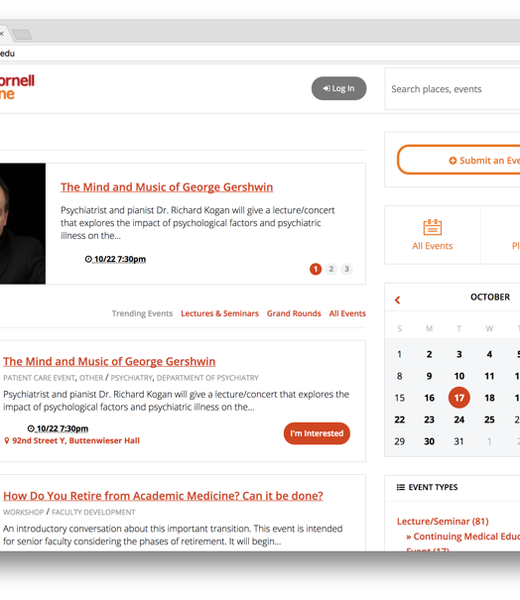
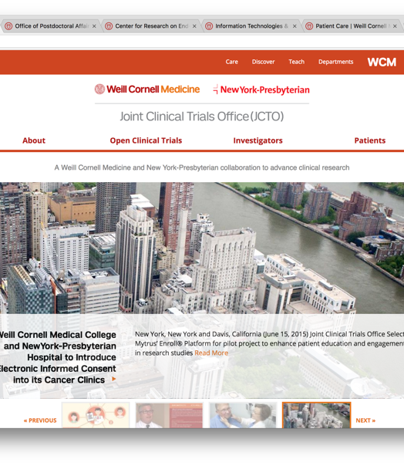
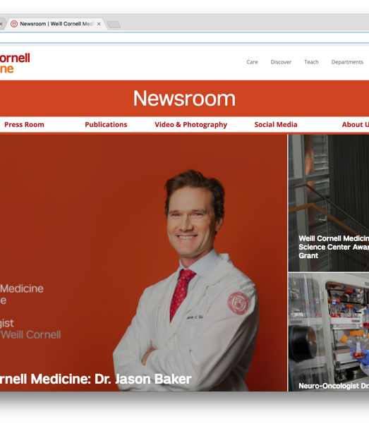
Centralized Content
Events Calendar
  3rd Party Application for managing events at WCM.
  Exposed JSON API.
Clinical Trials
  1000+ Clinical Trials.
  Exposed via a JSON view.
  Filterable by category.
Newsroom
  Main news website, updated daily by External Affairs.
  JSON view with multiple filters.

Slide 4
Events
https://events.weill.cornell.edu
Filterable by department, mission etc.
Feeds builder can be used to find the correct query string to return desired events
API exposed at http://events.weill.cornell.edu/api/
Example JSON: http://events.weill.cornell.edu/api/2/events?type=82700&days=370&pp=100
JSON View Chrome extension, displays JSON in a readable format. *Demo feeds and localist*

Slide 5
Feeds Module
Feed module allows Drupal to ingest content in the form of JSON, XML, CSV, RSS.
Dependencies: job scheduler, ctools.
Allows the user to define their own parser.
Parser is defined in a small module.
JSON View chrome plugin allows you to easily find the JSON field name.
Feed fields can then be mapped directly to the desired content type field.
Feed module can auto create taxonomy terms.
*Demo Feeds module*

Slide 6
Clinical Trials
Hosted on the Joint Clinical Trials Office (JCTO) website
Listed here: http://jcto.weill.cornell.edu/open-clinical-trials
JSON feed, filterable by disease category
https://live-wcmc-jcto.pantheonsite.io/open_clinical_trials/json?ct_disease_category[]=
Also includes a JSON feed of categories to allow the site to import and the taxonomy terms and map the Clinical Trials correctly.

Slide 7
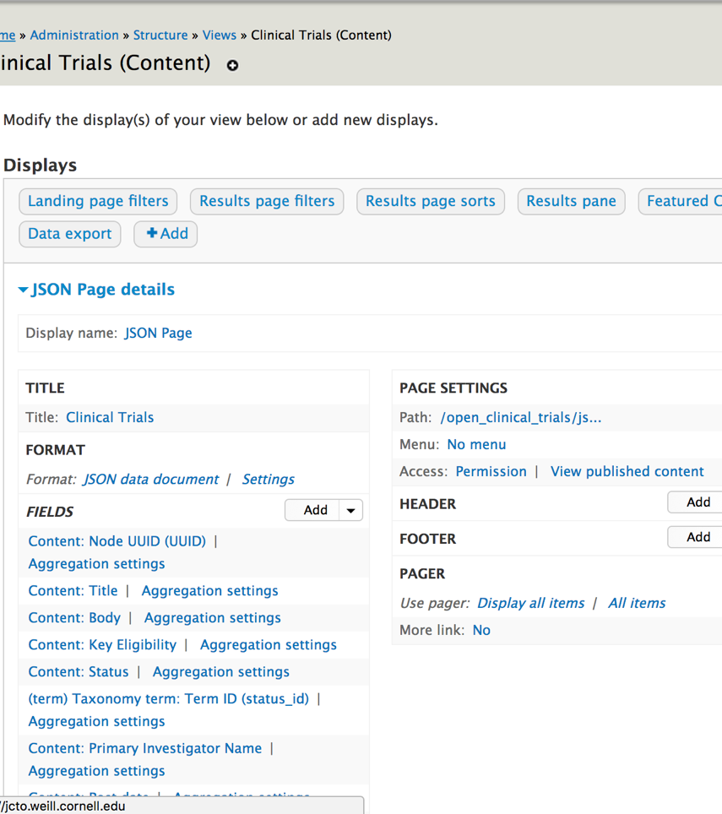
Views and Views Data Source
Views - a very popular query building module for Drupal.
Views Data Source adds formats to the views module to allow output in CSV, JSON, XML
The quickest way of adding getting JSON from your Drupal content.
Exposed filters can be added to filter the JSON
*Demo Views DataSource*

Slide 8
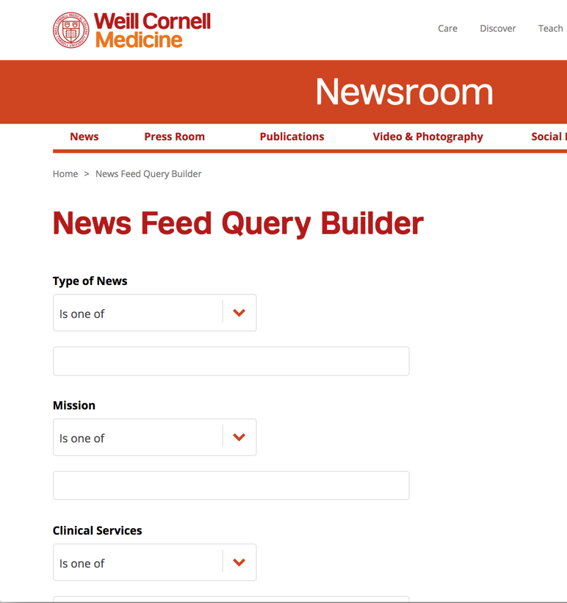
Newsroom
Similar to JCTO, with more filters.
Query builder built using exposed filters, allows users to build a custom XML feed. The same parameter can be used on the JSON feed.
Filter machine name can be found in the views settings
*Demo*

Slide 9

What about Drupal 8?
Feeds DEV version – not a lot of support
Migrate module, now in core
migrate_plus and migrate_tools.
Lots of .yml set up
Add “?_format=json” to any node URL to reveal JSON for that node.
JSON API module can be used list more content in one JSON request.
Further reading. Pull Content from a remote Drupal 8 site using migrate and JSON API https://www.lullabot.com/articles/pull-content-from-a-remote-drupal-8-site-using-migrate-and-json-api

Slide 10
Any Questions?

Slide 11
Thank You!

